Slide 1
COSMETICS RECOMMENDATION
DEPARTMENT OF ARTIFICIAL INTELLIGENCE AND DATA SCIENCE
PRESENTED BY
SAHAYA SHARLIN I (730323243044)

Slide 2
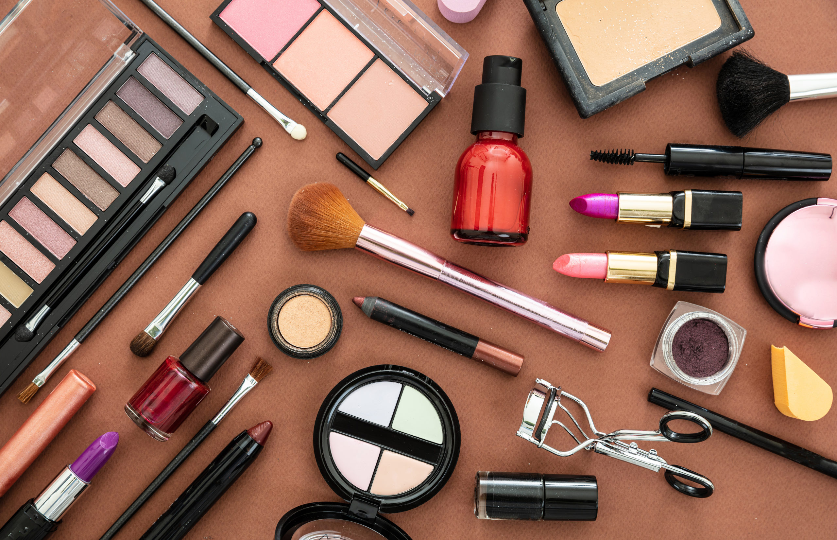
ABSTRACT
A recommendation system helps users select the right cosmetics based on personal needs.
The project uses K-Means clustering to group similar products and users.
Rule based and content based filtering are used to recommend the product
It improves shopping experience by suggesting the most suitable items.

Slide 3
INTRODUCTION
Many cosmetic products exist difficult for users to choose.
Recommendation systems reduce confusion and save time.
Machine learning helps provide personalized product suggestions.

Slide 4
OBJECTIVES
To develop a cosmetics recommendation system that suggests products based on skin type, price, and preferences.
To use the K-Means clustering algorithm for grouping similar products/users.

Slide 5
Existing System vs Proposed System
1. Existing System:
Manual selection of products.
Users depend on advertisements or random search.
2. Demerits of Existing System:
Time-consuming.
Not personalized.
3. Proposed System:
Uses K-Means clustering to group products.
Matches user input (skin type, price range) with suitable cluster.
4. Merits of Proposed System:
Personalized recommendation.
Faster and more accurate product selection.

Slide 6
System Architecture
Input: User details (skin type, price range, preferences).
Dataset: Products with brand, ingredients, price, ratings, skin-type compatibility.
Preprocessing: Clean dataset, remove duplicates, handle missing values.
Algorithm: Apply K-Means clustering, rulebased and recommended based filtering.
Output: Recommend products from the matching cluster and display the output .

Slide 7
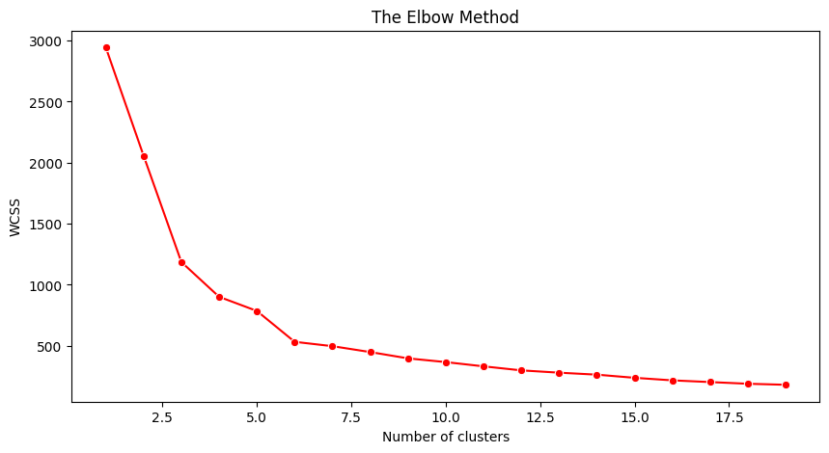
ALGORITHM
K-Means Clustering -->group products by Price & Rank
Rule-Based Filtering -->filter by skin type + budget
Content-Based Filtering --> use ingredients similarity (TF-IDF + cosine similarity)
Used Elbow Method to find best K (in this project -->3 clusters).

Slide 8
TOOLS
Python Programming Language.
Google Colab platform.
Libraries:
Pandas, NumPy – Data handling.
Matplotlib, Seaborn – Visualization.
Scikit-learn – for algorithms.

Slide 9
HARDWARE / SOFTWARE REQUIREMENT
Hardware:
Minimum: 4GB RAM, i3 processor.
Recommended: 8GB RAM, i5 processor.
Software:
Operating System: Windows/Linux.
Tools: Google Colab, Python 3.9.
Libraries: Pandas, Numpy, Scikit-learn, Seaborn, Matplotlib.

Slide 10
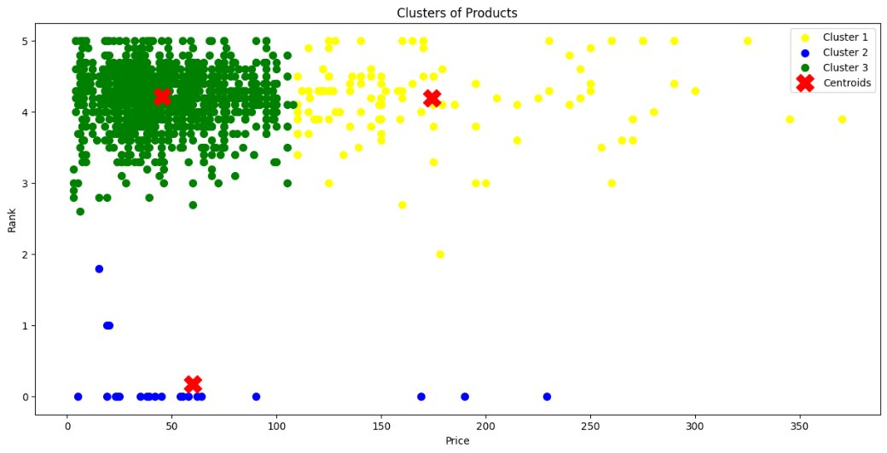
RESULTS
Dataset grouped into 3 clusters:
Cluster 1: Low price, medium rank products.
Cluster 2: Mid price, high rank products.
Cluster 3: High price, premium products.
Recommendations are given based on cluster matching.

Slide 11
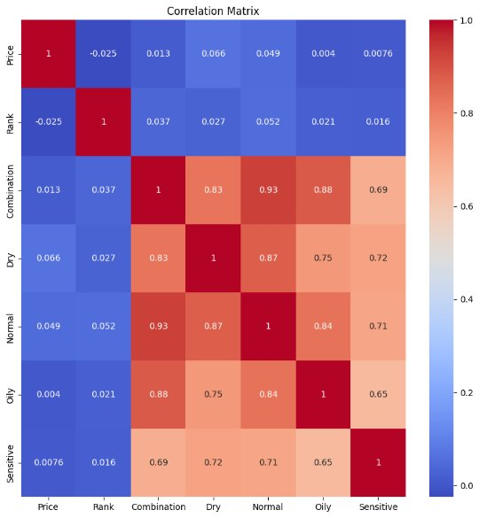
SCREENSHOTS
Heatmap: Shows correlation between features.
Pair Plot: Shows relation between price, rank, and skin type.
Elbow Curve: Best cluster number is 3.
Scatter Plot: Visualizes product clusters with centroids.
HEAT MAP​

Slide 12
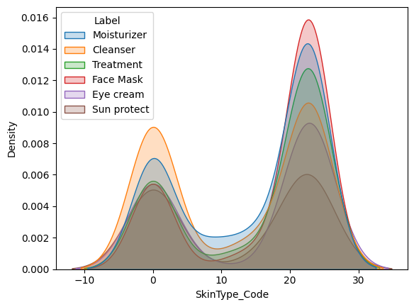
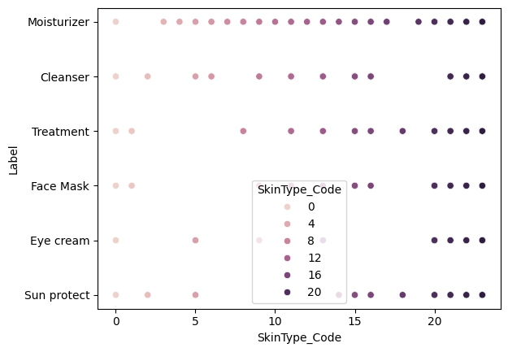
KDE PLOT​
SCATTER PLOT​

Slide 13
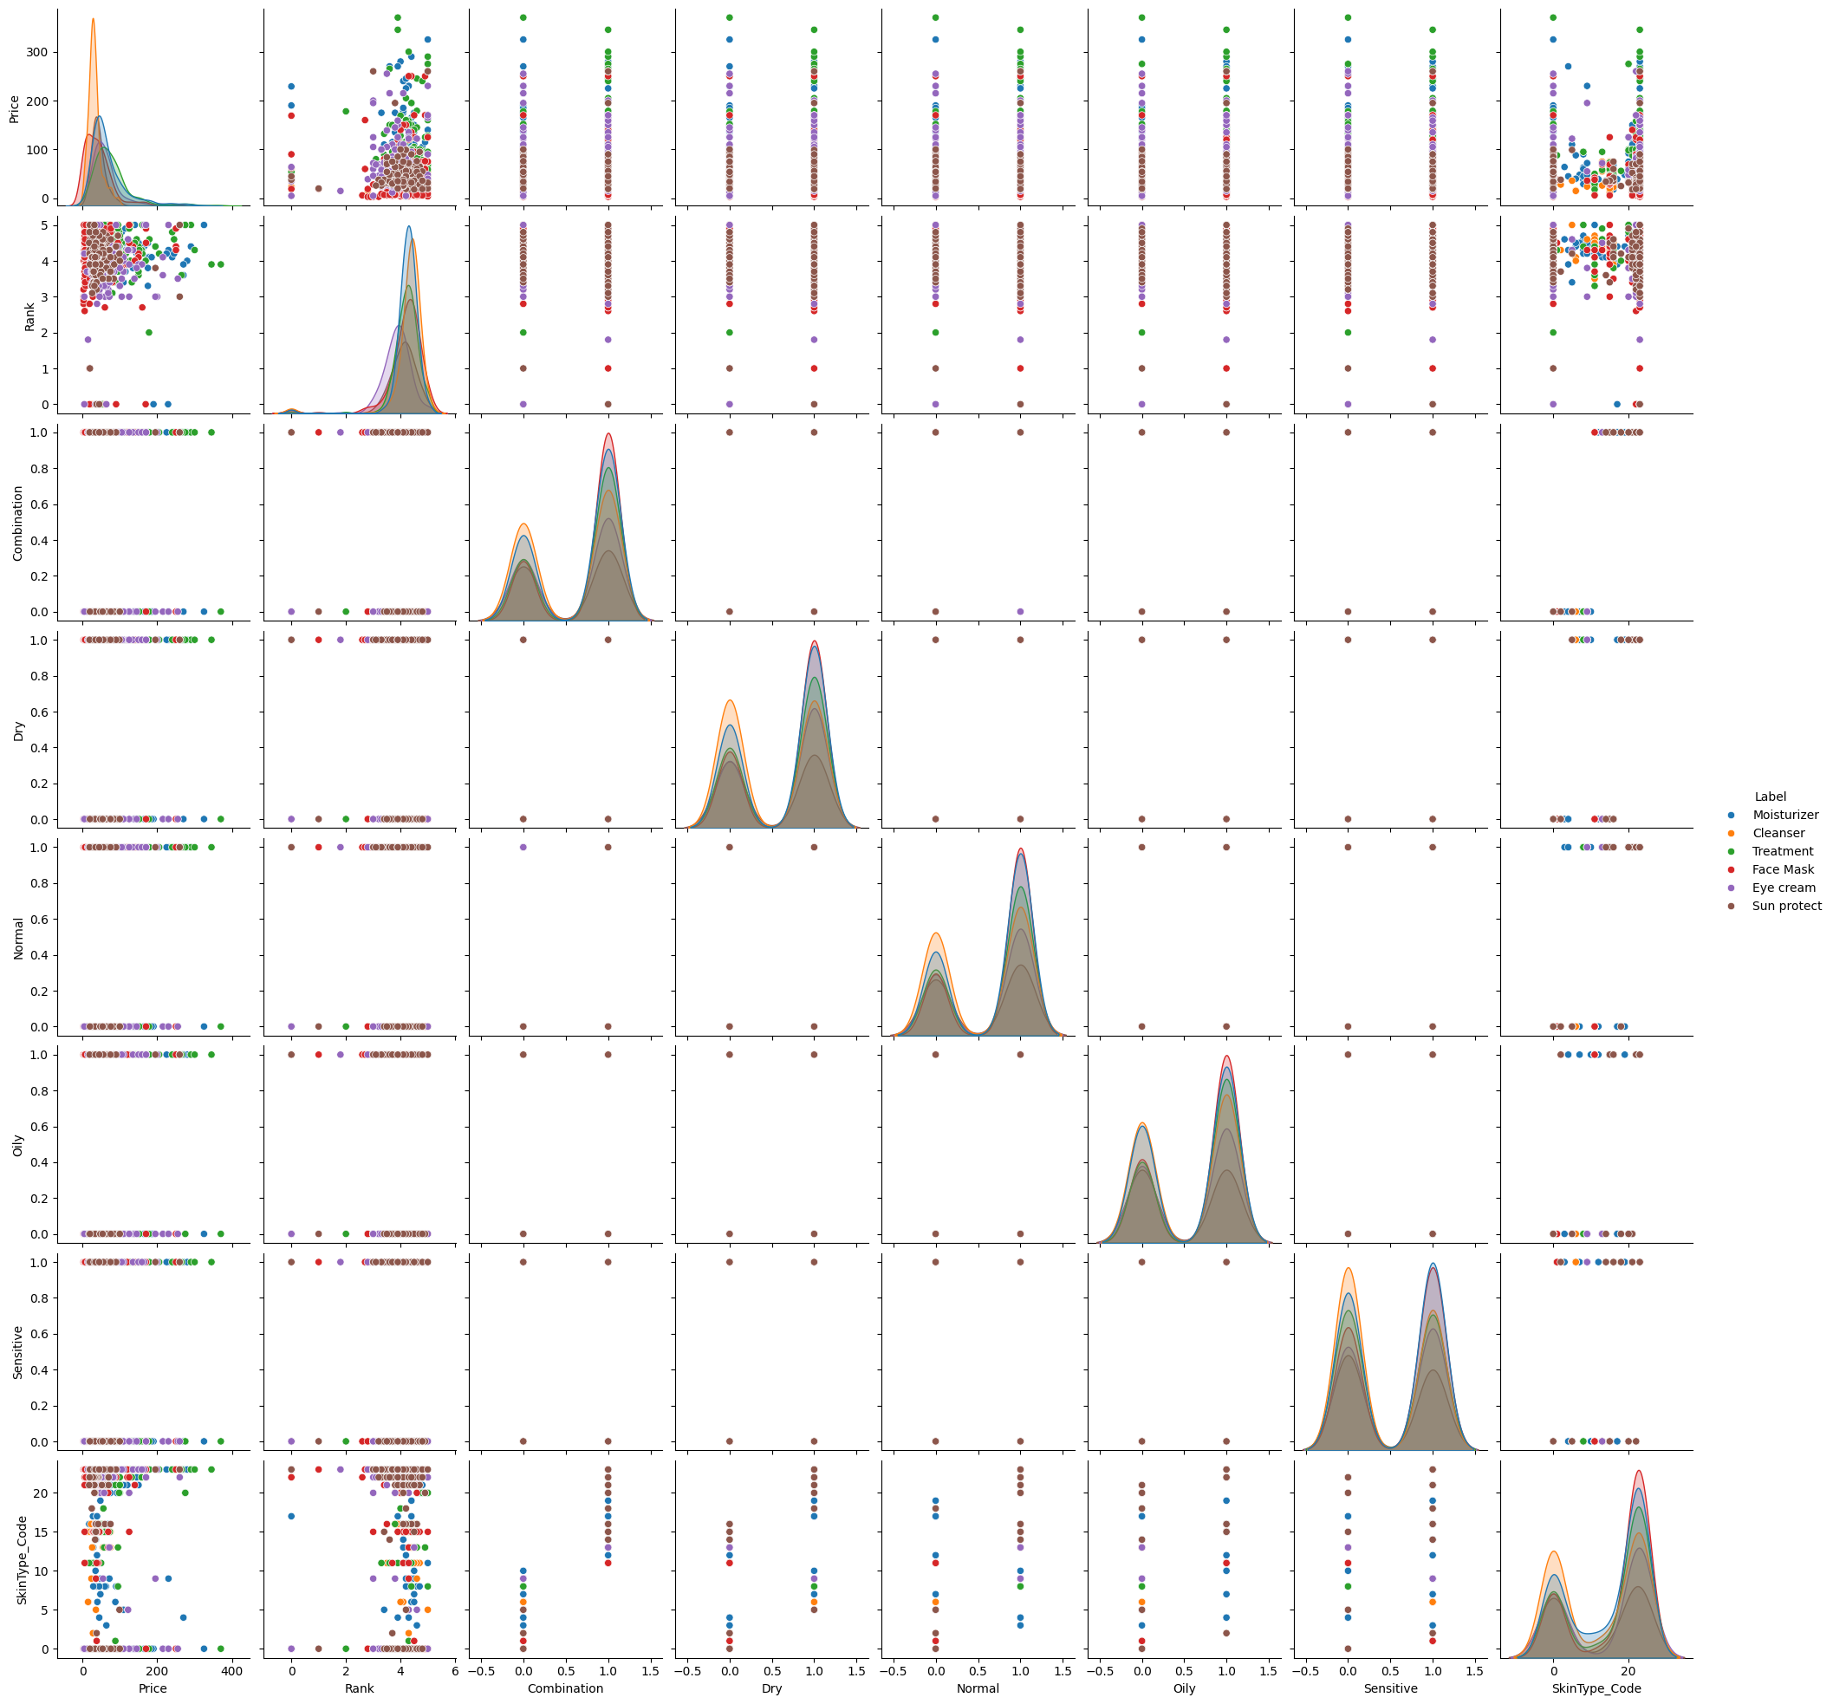
PAIR PLOT

Slide 14
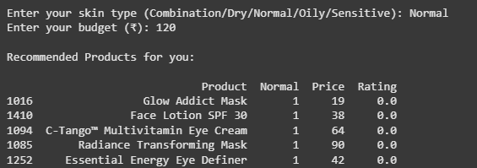
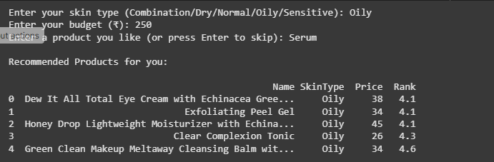
Rule based filtering
Recommended based filtering

Slide 15
CONCLUSIION
K-Means clustering helped me analyze and group cosmetics.
Rule-based + Content-based filtering helped me make real recommendations.
This project shows how machine learning can improve shopping experience.
It can be applied in e-commerce websites and beauty apps like Amazon, Nykaa, and Sephora.”

Slide 16


